Slide 1
The Trouble with Distributed Systems: Navigating Unreliability
Insights from "Designing Data-Intensive Applications," Chapter 8
Notes:
Hello everyone, and welcome! Today, we're going to dive into a fascinating and often challenging area of software engineering: distributed systems. Specifically, we'll be exploring Chapter 8 of Martin Kleppmann's excellent book, 'Designing Data-Intensive Applications,' which is aptly titled 'The Trouble with Distributed Systems.'
If you've ever worked on systems that span multiple computers, you've likely encountered some of the 'joys' we'll discuss today. This chapter is a bit of a reality check. While previous chapters might have seemed optimistic, this one cranks up the pessimism to eleven, forcing us to confront the myriad ways things can go wrong.
Our goal today isn't to scare you, but to equip you with a better understanding of the fundamental challenges. We'll look at why distributed systems are inherently different from single-machine programs, the common pitfalls like unreliable networks and clocks, and how these issues impact our ability to establish truth and consistency. By the end of this session, you should have a clearer picture of what we're up against when we build these complex systems and why robust design is so crucial. We'll cover key concepts, dive deep into specific problems, and then wrap up with a summary. Let's get started!"

Slide 2
Key Concepts - What is a Distributed System? Why is it Hard?
Distributed System: Multiple computers (nodes) connected by a network, working together.
Single Computer vs. Distributed System:
Single Computer: Predictable, deterministic (mostly). Failures are often total (crash).
Distributed System: Unpredictable, non-deterministic. Partial failures are the norm.
Why it matters: We can't just hope for the best. We must design for failure.
Notes:
So, what exactly are we talking about when we say 'distributed system'? At its core, it's a collection of independent computers, or nodes, that communicate and coordinate their actions over a network to achieve a common goal. Think of your favorite web service, a large-scale database, or a cloud application – these are all distributed systems.
Now, writing software for a single computer is one thing. It generally behaves predictably. Either it works, or it crashes. The hardware, when functioning, gives you the same result for the same operation. Computers are designed to present this idealized, almost perfect operational model.
But step into the world of distributed systems, and the picture changes dramatically. We're no longer in that idealized world. We're confronting the messy reality of the physical world where, as the chapter puts it, 'there are lots of new and exciting ways for things to go wrong.' The biggest shift in mindset is dealing with partial failures. This means some parts of your system might be broken or behaving erratically, while other parts are perfectly fine. This non-determinism – the idea that an operation might sometimes work and sometimes fail unpredictably – is what makes distributed systems so incredibly challenging to get right.
Why does this distinction matter so much? Because if we approach distributed system design with a single-computer mindset, we're setting ourselves up for disaster. We can't just assume things will work. We have to anticipate and design for a wide range of failures. Suspicion, pessimism, and even a bit of paranoia are actually virtues here!

Slide 3
Key Concepts - The Core Problems
The "Unholy Trinity" of Distributed System Woes:
Unreliable Networks: Messages get lost, delayed, reordered. You can't tell if the other side is down or just slow.
Unreliable Clocks: Each machine has its own clock, and they drift. Synchronization is imperfect. What time is it really?
Process Pauses: Your code can just... stop... for a while (think garbage collection, VM contention).
Consequence: Uncertainty. It's hard to know the true state of anything
Goal: Build reliable systems from unreliable components.
Notes:
Chapter 8 essentially highlights a few core areas where things consistently go sideways in distributed systems. I like to think of them as the 'unholy trinity' of distributed computing problems.
First, we have Unreliable Networks. We'll dive deeper into this, but the gist is that the network connecting our nodes is not a magic tube. Messages can get lost, arrive incredibly late, or even get duplicated or reordered. And when you send a message and don't get a reply, you're left guessing: Was my message lost? Is the other node down? Is the reply lost? This uncertainty is a constant companion.
Second, there are Unreliable Clocks. Every computer has its own physical clock, and these clocks are not perfectly accurate. They drift at different rates. We try to synchronize them using protocols like NTP, but this synchronization is never perfect and can itself be subject to network issues. This makes seemingly simple things, like figuring out the order of events across different machines, surprisingly difficult and fraught with peril.
Third, we have Process Pauses. This is a sneaky one. Your program, running on a node, can suddenly pause for a significant amount of time without you realizing it. This could be due to garbage collection in languages like Java or Python, contention for CPU in virtualized environments, or even operating system-level activities. While your process is paused, the rest of the distributed system marches on, potentially assuming your node is dead.
The overarching consequence of these problems is profound uncertainty. It becomes incredibly difficult for any single node to know the true, current state of other nodes, or even the precise timing of events. Our grand challenge, then, is to somehow build reliable systems – systems that meet user expectations and guarantees – out of these fundamentally unreliable components. It sounds a bit like magic, but it's what distributed systems engineering is all about.

Slide 4
Deep Dive 1: Partial Failures & Unreliable Networks
Single computer: Usually fully functional or entirely broken.
Distributed system: Some nodes/components can fail while others continue.
Examples: Network cable unplugged, switch failure, power outage to a rack, software crash on one node.
Nondeterminism: Operations involving multiple nodes may work sometimes, fail unpredictably other times.
Why this is hard:
Difficult to detect what failed.
Difficult to know the state of the failed component.
System must continue operating in a degraded but correct state
Notes:
Let's first dig into this idea of partial failures, because it's really the defining characteristic of distributed systems. On a single computer, if something goes seriously wrong with the hardware, like memory corruption, the whole system usually crashes – think of a kernel panic or a blue screen of death. It's an all-or-nothing situation. This is often a deliberate design choice: it's better for a computer to stop completely than to give you wrong answers.
In a distributed system, however, the game is different. You might have one server in a cluster of fifty that crashes. Or a network switch connecting a rack of servers might go down. Or, as Coda Hale's anecdote in the book humorously points out, a hypoglycemic driver might crash his truck into the datacenter's HVAC system! The point is, parts of the system can fail in unpredictable ways, while other parts are chugging along just fine. This is what we mean by a partial failure.
This leads to nondeterminism. If you're trying to perform an operation that involves multiple nodes and the network – say, writing data to a replicated database – it might work perfectly one moment, and then fail the next due to a network glitch or a node becoming unresponsive. You might not even know if your operation succeeded or failed.
Why is this so hard to deal with? Well, first, it's tough to even detect what exactly has failed. Is it the remote node? Is it the network path to it? Is it the network path from it? Second, you often don't know the state of the component you can't reach. Did it process your request before it died? And crucially, the rest of the system often needs to continue operating, perhaps in a degraded state, but it must still behave correctly and not lose data or produce inconsistent results. This requires building fault-tolerance right into the software.

Slide 5
The Unreliable Network - It's Out to Get You!
Asynchronous packet networks (Internet, Ethernet): No guarantees on delivery or timing.
When you send a request and expect a response, many things can go wrong:
Request lost.
Request queued (network/recipient overloaded).
Remote node failed.
Remote node temporarily unresponsive (e.g., GC pause).
Response lost.
Response delayed.
Sender's predicament: Impossible to distinguish these scenarios without a response.
Notes:
Alright, let's talk about the network. In most distributed systems, especially those built for internet services or in typical datacenters, we're dealing with asynchronous packet networks. Think of Ethernet and IP, the protocols that underpin the internet and most local networks. The key thing to understand about these networks is that they offer very few guarantees. When one node sends a message, or a packet, to another node, the network doesn't promise when it will arrive, or even if it will arrive at all.

Slide 6
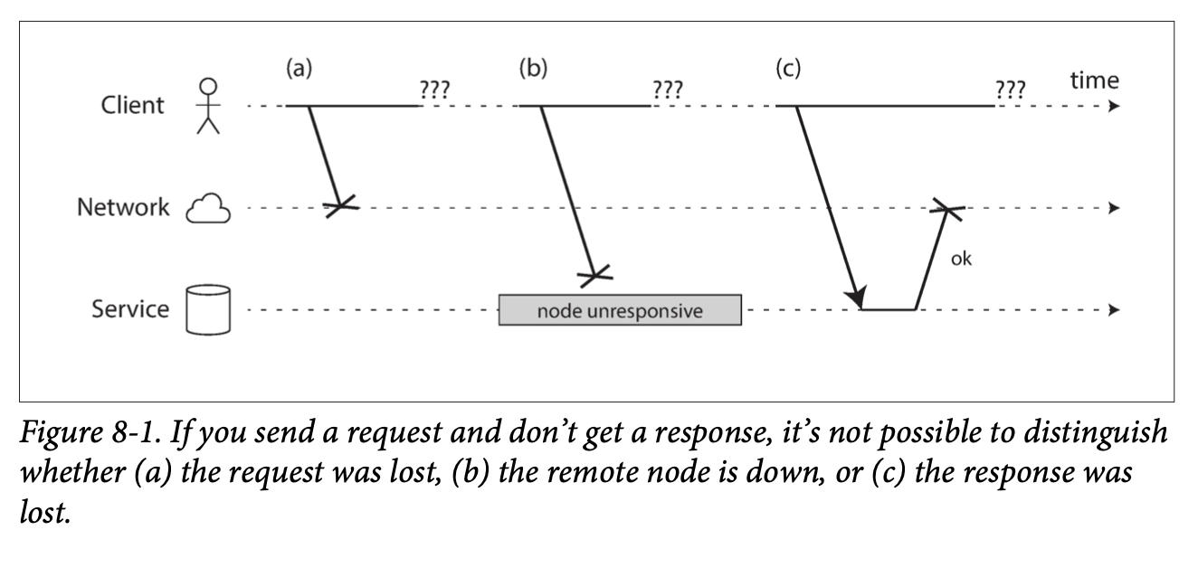
The Unreliable Network - It's Out to Get You!
Notes:
Now, imagine your client application sends a request to a service running on another node. As Figure 8-1 here illustrates, a lot can go wrong.
(a) Your request might simply be lost in transit – maybe a network cable was briefly disconnected, or a router dropped the packet because it was overloaded.
(b) Your request might be sitting in a queue somewhere, waiting to be processed, perhaps because the network is congested or the receiving node is swamped with other requests. It will be delivered, but later.
(c) The remote node itself might have failed – it crashed or was powered down.
(d) The remote node might be temporarily unresponsive. Perhaps it's in the middle of a long garbage collection pause, as we discussed earlier, and will come back to life soon.
(e) The remote node might have processed your request perfectly, but the response it sent back to you got lost on the network.
(f) Or, the remote node processed your request, sent a response, but that response is delayed, perhaps because your own machine or the network path back is overloaded.
From the sender's perspective, if you don't get a response, all these situations look identical. You simply don't know why you haven't heard back. The only information you have is the silence. This fundamental uncertainty is a huge source of complexity.

Slide 7
Detecting Faults - The Timeout Dilemma
How do we know if a node is down? Usually, with timeouts.
Timeout: After some period, assume the response isn't coming.
Problem: Still don't know if the request was processed.
Choosing a timeout value:
Too long: Slow fault detection, users wait, system remains in degraded state.
Too short: Risk of falsely declaring a live node dead if it's just slow (due to load, network spike).
Consequence: Cascading failures if load is redistributed to already struggling nodes.
There's no "perfect" timeout value in networks with unbounded delays.
Notes:
So, if the network is unreliable and we can't be sure why we're not getting a response, how do we even detect if another node is faulty or has crashed? The most common mechanism, and often the only one available, is a timeout. You send a request, you wait for a certain amount of time, and if no response arrives within that window, you give up and assume the operation failed or the remote node is unavailable.
But here's the catch: even when a timeout occurs, you still don't know for sure what happened to your original request. Did the remote node receive it? Did it process it? If it was a write operation, was the data written? You have no idea. And worse, that request might still be queued somewhere and could be delivered and processed after you've already timed out and perhaps even retried the operation with another node.
This brings us to the crucial question: how long should the timeout be? This is a really tricky balancing act. If you set a long timeout, it means you'll wait a long time before declaring a node dead. During this waiting period, users might be staring at a spinning wheel, or your system might be unable to make progress. On the other hand, if you set a short timeout, you detect faults faster, which seems good. But you run a much higher risk of incorrectly declaring a node dead when it's actually alive but just temporarily slow – perhaps due to a sudden load spike or a transient network hiccup.
Prematurely declaring a node dead is a big problem. If that node was in the middle of doing something important, and another node takes over its responsibilities, that action might end up being performed twice. Imagine sending an email twice, or processing a payment twice! Furthermore, if the system is already under high load, and you start declaring nodes dead because they're slow to respond, you shift their load onto the remaining nodes, which can make them slow, leading to more false positives, and potentially a cascading failure where the entire system grinds to a halt.
In networks like the internet or typical datacenter Ethernets, which have unbounded delays (meaning there's no theoretical upper limit on how long a packet might take), there's unfortunately no single 'correct' or 'perfect' timeout value. It's always a trade-off based on observed conditions and application requirements

Slide 8
Unbounded Delays - Why is the Network So Slow Sometimes?
Packet networks (Ethernet, IP) are optimized for bursty traffic, not guaranteed latency.
Main cause of variable delay: Queueing.
Network switches queue packets if multiple sources send to one destination (congestion).
OS queues incoming requests if CPU is busy.
VMs can be paused, buffering incoming data.
TCP flow control (congestion avoidance) adds sender-side queueing.
Highly utilized systems = longer queues.
Takeaway: Expect delays, and expect them to be variable.
Notes:
Why are these network delays so variable and unbounded? Why can't we just have a network that guarantees packets arrive within, say, 10 milliseconds? To understand this, we need to look at how networks like Ethernet and IP are designed. They are packet-switched networks, optimized for what we call 'bursty' traffic. Think about requesting a web page or sending an email. You send a burst of data, then maybe there's a pause, then another burst. These networks try to use the available capacity efficiently by dynamically allocating bandwidth as needed. This is different from, say, an old-fashioned telephone call, which used circuit switching to reserve a fixed amount of bandwidth for the entire duration of the call, guaranteeing low latency.

Slide 9
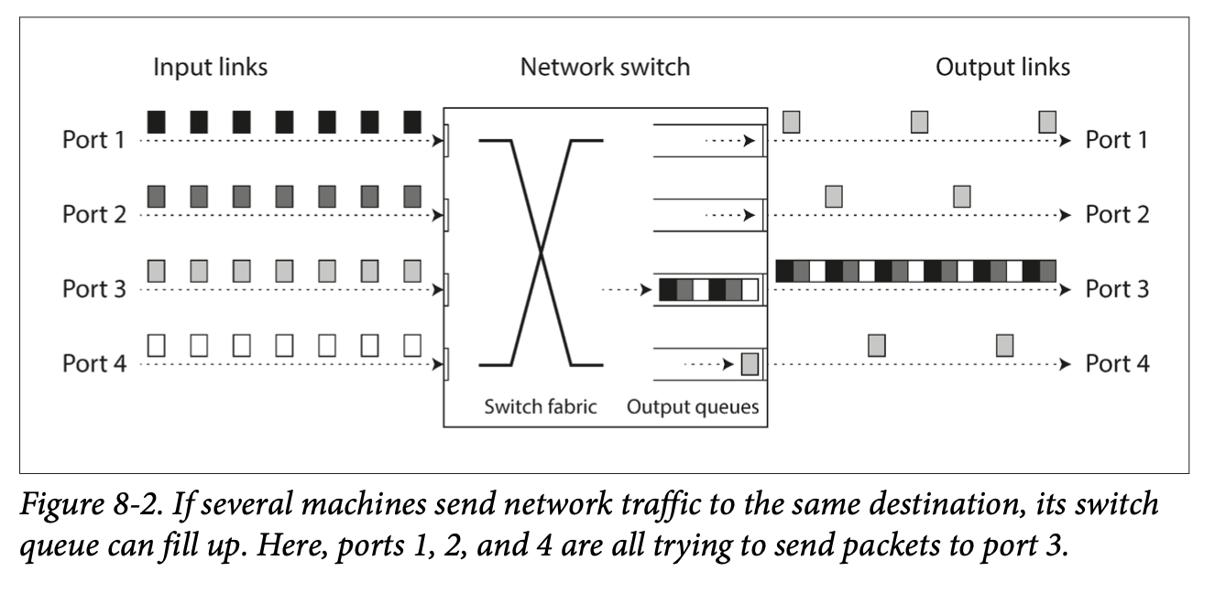
Unbounded Delays - Why is the Network So Slow Sometimes?
Notes:
The main culprit for variable delays in packet-switched networks is queueing. (Presenter should point to the embedded Figure 8-2 on the slide) As Figure 8-2 shows, if several different nodes are all trying to send packets to the same destination simultaneously, the network switch in the middle has to handle this. It has input ports and output ports. If packets arrive on multiple input ports destined for the same output port faster than that output port can send them, the switch has to queue them up. If the queue gets full, packets are dropped. This is network congestion.
But queueing doesn't just happen in network switches.
When a packet arrives at the destination machine, if all its CPU cores are busy, the operating system will queue the incoming request until the application is ready to handle it.
In virtualized environments, a running operating system can be paused for tens of milliseconds while another virtual machine uses a CPU core. During this pause, the VM can't consume data from the network, so incoming data gets buffered by the hypervisor, adding more delay.
Even TCP, the protocol we often rely on for 'reliable' communication, performs flow control or congestion avoidance. This means if TCP detects the network is getting congested, or the receiver is slow, it will actually limit its own sending rate, which often means queueing data at the sender before it even enters the network.
The closer a system is to its maximum capacity, the longer these queues can become, and the more variable the delays. So, the key takeaway is that we must expect delays in distributed systems, and crucially, we must expect those delays to be highly variable and sometimes very long.

Slide 10
The Trouble with Time - Clocks Aren't Perfect
Applications rely on clocks for:
Timeouts, performance metrics (durations).
Timestamps, scheduling, cache expiry (points in time).
Problem: Each machine has its own physical clock (quartz oscillator).
These clocks are not perfectly accurate and drift.
Network Time Protocol (NTP) synchronizes clocks, but:
Accuracy is limited by network delay.
NTP servers can be wrong or misconfigured.
Local clock can be forcibly reset (jump backward/forward).
Leap seconds can cause chaos.
Result: Time is not absolute in a distributed system.
Notes:
Let's switch gears and talk about another fundamental source of trouble: time itself, or rather, our computer clocks. Clocks are everywhere in software. We use them to measure durations – like, has this request timed out yet? What's the 99th percentile response time of our service? And we use them to mark points in time – when was this article published? When should this cache entry expire?
It all seems straightforward until you realize that in a distributed system, each machine has its own physical clock, usually a quartz crystal oscillator. And these hardware clocks are not paragons of accuracy. They drift, meaning they run slightly faster or slower than they should, and they drift at different rates on different machines, and even on the same machine if the temperature changes.
We try to tame this chaos using the Network Time Protocol, or NTP. NTP allows a computer's clock to be adjusted according to time reported by a group of servers, which in turn get their time from more accurate sources like GPS receivers. However, NTP is not a silver bullet.
Its accuracy is fundamentally limited by the network delay between your machine and the NTP server. If that delay is variable, so is your clock accuracy. Errors of tens of milliseconds are common over the internet, and spikes to over 100ms can happen.
NTP servers themselves can be wrong or misconfigured.
If your local clock is too far off from the NTP server, it might be forcibly reset, causing time to suddenly jump backward or forward. Imagine the confusion that can cause for your application logic!
And then there are leap seconds – those occasional extra seconds added to UTC to keep it in sync with solar time. They can cause minutes to be 59 or 61 seconds long, which has historically crashed many large systems that weren't prepared for it.
The bottom line is that time in a distributed system is not the simple, absolute, universally agreed-upon concept we might wish it to be. Each node has its own slightly skewed perception of time.

Slide 11
Monotonic vs. Time-of-Day Clocks - Know Your Clock!
Computers have (at least) two types of clocks:
Time-of-Day Clock (Wall-clock time)
Returns current date and time (e.g., seconds since epoch).
Synchronized with NTP (ideally).
Can jump backward or forward (NTP reset, manual changes, leap seconds).
Unsuitable for measuring elapsed time.
Monotonic Clock
Always moves forward.
Suitable for measuring durations (timeouts, intervals).
Absolute value is meaningless (e.g., nanoseconds since boot).
Cannot compare values between different machines.
Why it matters: Using the wrong clock for a task can lead to subtle bugs.
Notes:
To navigate these timing issues, it's crucial to understand that modern computers typically provide at least two different kinds of clocks: time-of-day clocks and monotonic clocks. They both measure time, but they serve very different purposes.
First, the Time-of-Day Clock, often called wall-clock time. This is what you intuitively think of as a clock. It returns the current date and time according to some calendar – for example, System.currentTimeMillis() in Java or clock_gettime(CLOCK_REALTIME) in Linux typically give you the number of milliseconds or seconds since the Unix epoch (January 1, 1970, UTC). These clocks are usually synchronized with NTP, so ideally, a timestamp from one machine means the same as on another. However, as we just discussed, time-of-day clocks can be problematic. They can jump backward if NTP decides the clock is too far ahead, or jump forward. They also often ignore leap seconds in a way that can be confusing. Because of these jumps, they are generally unsuitable for measuring elapsed time accurately.
That's where the Monotonic Clock comes in. Examples include System.nanoTime() in Java or clock_gettime(CLOCK_MONOTONIC) in Linux. As the name suggests, a monotonic clock is guaranteed to always move forward. It will never jump backward. This makes it perfect for measuring durations or time intervals – for example, how long an operation took, or when a timeout should expire. You read its value, do something, and read it again; the difference tells you the elapsed time. However, the absolute value of a monotonic clock is usually meaningless. It might be the number of nanoseconds since the computer last booted, or some other arbitrary reference point. Critically, this means you cannot compare monotonic clock values from two different computers – they simply don't have a shared reference.
Why is this distinction so important? Because using the wrong type of clock for a particular task is a recipe for subtle, hard-to-diagnose bugs. If you try to measure a timeout using a time-of-day clock, and that clock jumps backward, your timeout might fire prematurely or much later than intended.

Slide 12
Dangers of Relying on Clocks - Ordering Events
Tempting to use timestamps to order events across nodes.
Example: Last Write Wins (LWW) conflict resolution.
Problem: Clock skew. A causally later event can have an earlier timestamp.
Logical clocks (e.g., version vectors) are safer for ordering than physical clocks.
We'll walk through a scenario in the next slide
Notes:
One of the most dangerous temptations when dealing with clocks in distributed systems is to use timestamps from time-of-day clocks to determine the order of events that happened on different nodes. A common example of this is the 'Last Write Wins' or LWW conflict resolution strategy, which is used in some multi-leader replication systems and leaderless databases. The idea is simple: if there are conflicting writes to the same data, just pick the one with the latest timestamp and discard the others.
Sounds reasonable, right? The problem is clock skew. Even with NTP, clocks on different machines can be slightly out of sync. This can lead to situations where an event that happened causally later gets an earlier timestamp.

Slide 13
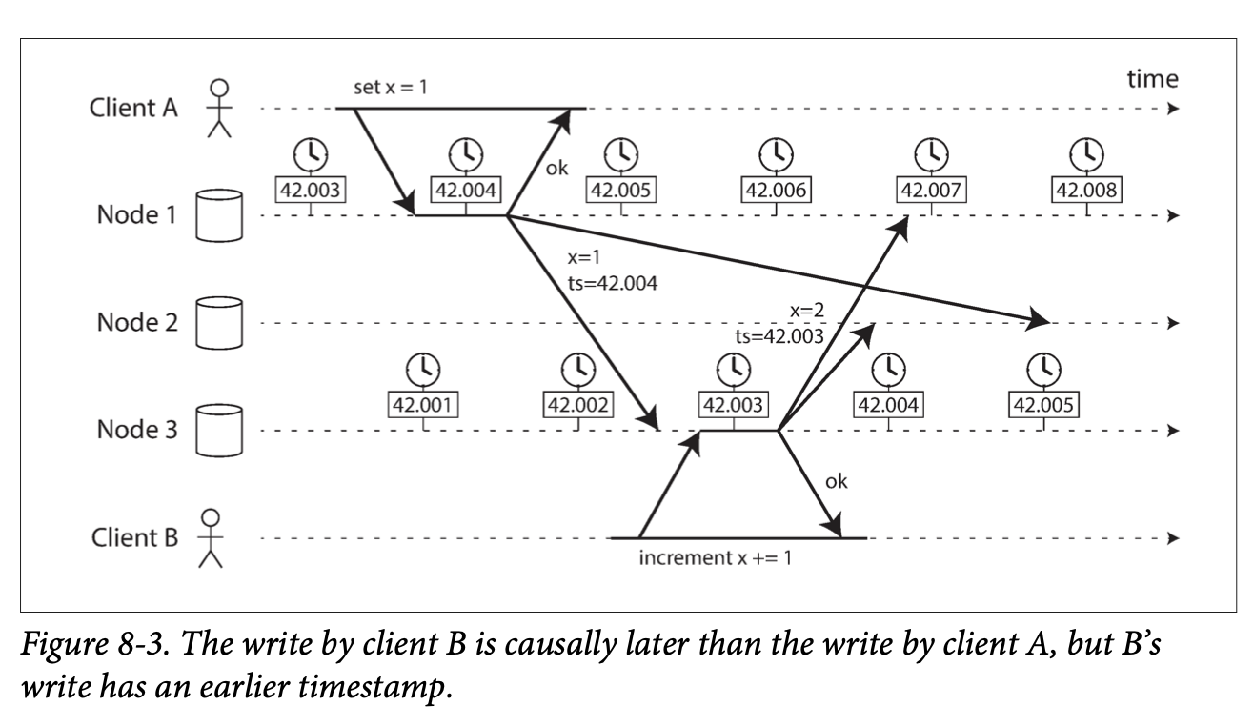
Dangers of Relying on Clocks - Ordering Events
Notes:
Let's look at Figure 8-3. Here, Client A writes a value, let's say x=1, to Node 1.
This write is tagged with a timestamp from Node 1's clock, say 42.004 seconds.
This write is then replicated to Node 3. Now, Client B connects to Node 3 and performs an operation that depends on Client A's write – say, it increments x, so x becomes 2.
This write by Client B occurs on Node 3 and gets a timestamp from Node 3's clock. Let's imagine Node 3's clock is just a tiny bit behind Node 1's clock, so this causally later write gets a timestamp of 42.003 seconds.
Finally, both of these writes are replicated to Node 2. Node 2 now sees two versions of x: x=1 with timestamp 42.004, and x=2 with timestamp 42.003. If Node 2 uses LWW, it will conclude that x=1 is the more recent value because 42.004 is greater than 42.003. As a result, Client B's increment operation is completely lost, silently!
This isn't a theoretical edge case; it happens in real systems. LWW based on unsynchronized or imperfectly synchronized physical clocks can lead to data loss and violations of causality. For correctly ordering events, especially when causality matters, logical clocks, like version vectors which we might have touched upon in replication discussions, are a much safer alternative. They don't rely on physical time but rather on tracking the causal dependencies between events

Slide 14
Process Pauses - The Silent Killer
A node's process can pause unexpectedly for significant durations:
Garbage Collection (GC) "stop-the-world" pauses (can be seconds or even minutes!).
Virtual Machine (VM) suspension/migration.
OS context switching, hypervisor scheduling (steal time).
Synchronous disk I/O, page faults (swapping).
Problem: Node believes it's active, but the world moved on.
Example: Leader holding a lease.
Checks lease: lease.expiryTimeMillis - System.currentTimeMillis() > 10000 (OK)
Process pauses for 15 seconds here
Lease has expired, another node became leader.
Paused node resumes, thinks lease is still valid, processes request -> Data corruption! (This logic is similar to what's discussed around Figure 8-4)
Cannot assume code execution is continuous.
Notes:
Now for another subtle but critical issue: process pauses. Your application code running on a node can be preempted and paused at almost any point, for a surprisingly long time, and your code won't even know it was paused when it resumes.
What can cause such pauses?
A very common one in languages like Java, Python, Go, C# is Garbage Collection. Some garbage collectors need to 'stop the world' – pause all application threads – to do their work. These pauses can sometimes last for several seconds, or in poorly tuned or heavily loaded systems, even minutes!
If you're running in a Virtualized Environment, your entire Virtual Machine can be suspended by the hypervisor, for example, to allow another VM to use the CPU, or during a live migration of your VM to another physical host. These pauses can be tens of milliseconds or longer.
Even without full GC stops or VM suspensions, the Operating System is constantly context-switching between threads, and if you're in a VM, the hypervisor is scheduling different VMs. If there's heavy load, your thread might wait a while before it gets to run again. The time your VM wanted to run but couldn't because the physical CPU was given to another VM is called 'steal time'.
If your application performs synchronous disk I/O, it will pause waiting for the disk. If it's a network-attached disk, network latency adds to this. And if the OS starts swapping memory pages to disk (paging) due to memory pressure, even simple memory access can trigger a slow disk I/O and pause your thread.
Why are these pauses so dangerous in a distributed system? Consider a common pattern: a leader node in a database partition holds a lease, which is like a lock with a timeout. The leader periodically renews the lease. It might have code that looks like this: it checks if its lease has, say, at least 10 seconds remaining. If it does, it proceeds to process a request. Now, imagine right after the check passes, the process gets hit by a 15-second GC pause. During those 15 seconds, its lease expires. Other nodes in the system detect this, elect a new leader, and the new leader starts handling requests. Then, our original leader's process resumes. It has no idea it was paused for 15 seconds! From its perspective, very little time has passed since it checked the lease. It still thinks its lease is valid and proceeds to process the request it was working on. If this involves writing data, it could now conflict with writes from the new actual leader, leading to data corruption or inconsistencies. This is precisely the kind of issue that can lead to the problems shown in Figure 8-4, which we'll discuss next in the context of locks.
The critical takeaway is that we cannot assume our code execution is continuous. A node must assume its execution can be paused for a significant length of time at any point

Slide 15
What Can We Really Know? The Uncertainty Principle
A node in a distributed system cannot know anything for sure.
It can only make guesses based on messages it receives (or doesn't receive).
Cannot reliably distinguish network problems from node problems.
Examples:
Is the remote node down, or is the network to it down?
Did my message get processed, or did the reply get lost?
Is my clock accurate, or am I seeing stale data?
This uncertainty is fundamental.
Notes:
Given all these issues with unreliable networks, clocks, and process pauses, we arrive at a rather profound point: a node in a distributed system operates in a fog of uncertainty. It cannot know anything for sure about the state of other nodes or the timing of events. It can only make educated guesses based on the messages it sends and receives – or, crucially, doesn't receive – over the network.
Think about it:
If a remote node doesn't respond, is that node down? Or is the network path to it broken? Or is the path from it broken, so you can't hear its replies? You can't be certain.
If you send a request and don't get a response after a timeout, did the remote node process your request before it (potentially) failed? Or was the request lost? Or was the response lost? Again, uncertainty.
Is your local clock telling you the accurate time? Or is it skewed, leading you to misinterpret the recency of data you're seeing from other nodes?
This isn't just academic; it has real-world implications for how we design algorithms. A node might think it's the leader, or that it holds a lock, or that its data is up-to-date, but that belief might be wrong due to these underlying unreliabilities. This fundamental uncertainty is something we must always keep in mind when reasoning about distributed systems.

Slide 16
The Truth is Defined by the Majority - Quorums
A single node cannot be trusted to make critical decisions (it might be faulty, isolated, or paused).
Many distributed algorithms rely on a quorum: voting among nodes.
Decision requires a minimum number of votes (e.g., a majority > N/2 nodes).
Why quorums?
Tolerance: System can continue if some nodes fail (e.g., 1 out of 3, 2 out of 5 for majority).
Safety: Prevents split-brain. There can only be one majority.
If a quorum declares a node dead, it is dead (from the system's perspective), even if the node itself feels alive. The node must abide.
Notes:
So, if individual nodes live in this state of uncertainty and can't fully trust their own perception, how do we make reliable decisions in a distributed system? How do we define 'truth'? One powerful concept used in many distributed algorithms is the quorum.
A quorum is essentially a voting mechanism among a set of nodes. Instead of allowing a single node to make a critical decision (like 'Am I the leader?' or 'Is this data committed?'), the decision requires support from a minimum number of nodes – the quorum. Most commonly, a quorum is defined as an absolute majority of nodes – that is, more than half. For example, in a 5-node system, a majority quorum would be at least 3 nodes.
Why are quorums so useful? First, they provide fault tolerance. If you require a majority, a system with 3 nodes can tolerate 1 node failing, and a system with 5 nodes can tolerate 2 nodes failing, and the remaining nodes can still form a quorum and make decisions. Second, and very importantly, they provide safety, particularly in preventing 'split-brain' scenarios. Because there can only be one majority in the system at any given time, you can't have two different groups of nodes independently making conflicting decisions, both believing they have the authority.
This has a fascinating implication: the 'truth' in a distributed system is often defined by what the majority agrees upon. If a quorum of nodes declares another node to be dead (perhaps because it stopped responding), then from the perspective of the system, that node is dead, and its responsibilities must be transferred. This is true even if the node itself is actually alive and just temporarily disconnected or paused. That node, upon rejoining or waking up, must abide by the quorum's decision and step down from any roles it thought it had. It cannot trust its own isolated judgment over the consensus of the group.

Slide 17
The Stale Leader/Lock Problem
Problem: A node believes it's "the chosen one" (leader, lock holder) but the system has moved on.
We'll walk through a scenario in the next slide
Notes:
Let's look at a concrete example of what can go wrong when a node mistakenly believes it's 'the chosen one' – perhaps it thinks it's the leader for a database partition, or it holds an exclusive lock for a resource. This is often due to the process pauses we discussed earlier.

Slide 18
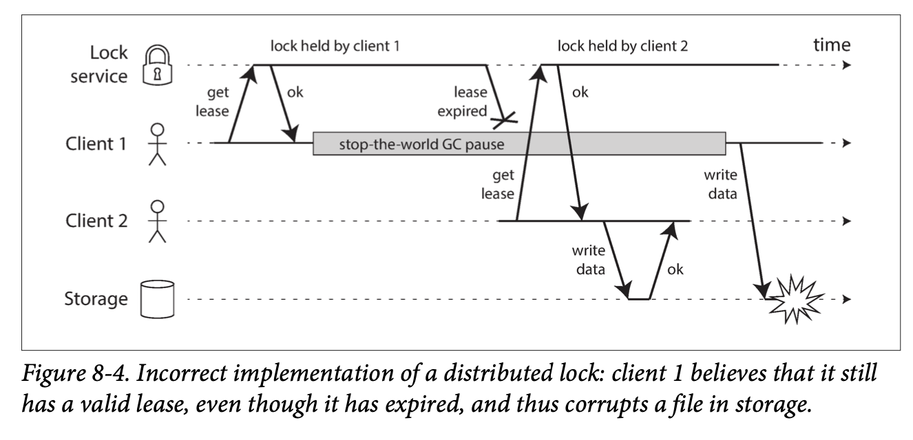
The Stale Leader/Lock Problem
Notes:
Consider the scenario in Figure 8-4, which illustrates a common bug with distributed locks if not implemented carefully. Imagine we have a storage service, and we want to ensure that only one client can write to a specific file at any given time to prevent corruption. So, we introduce a lock service. A client must obtain a lease (a lock with a timeout) from this service before accessing the file. (Presenter should point to the embedded Figure 8-4 on the slide)
Here's how it can go wrong:
Client 1 requests and obtains a lease for the file from the lock service. Great, it now believes it has exclusive access.
Client 1 then goes into a long pause – maybe a stop-the-world garbage collection kicks in for many seconds.
While Client 1 is paused, its lease at the lock service expires. The lock service now sees the lock as available.
Client 2 comes along, requests the lock for the same file, and the lock service grants it. Client 2 now starts writing to the file, believing it has exclusive access.
Eventually, Client 1 wakes up from its long pause. Crucially, from its perspective, it checked its lease status before the pause and it was valid. It has no idea that so much time has passed and its lease has expired. So, it proceeds to write to the file as well.
The result? Both Client 1 and Client 2 are writing to the file concurrently, leading to data corruption. Client 1 was operating under a stale, incorrect belief about its lock status. This kind of problem has affected real systems, like older versions of HBase.

Slide 19
Fencing Tokens - A Solution for Stale State
Solution: Fencing Tokens.
Lock service, when granting a lease, also returns a token (a number that strictly increases with each grant).
Client must include this token with every write request to the resource (e.g., storage service).
Storage service tracks the highest token seen for a resource.
Rejects requests with an older (smaller) token.
Lets walk through a diagram to see how this works
Notes:
So, how do we protect against these 'zombie' nodes that act on stale information, like the paused client in our lock example? A clever and widely used technique is called fencing, often implemented with fencing tokens.

Slide 20
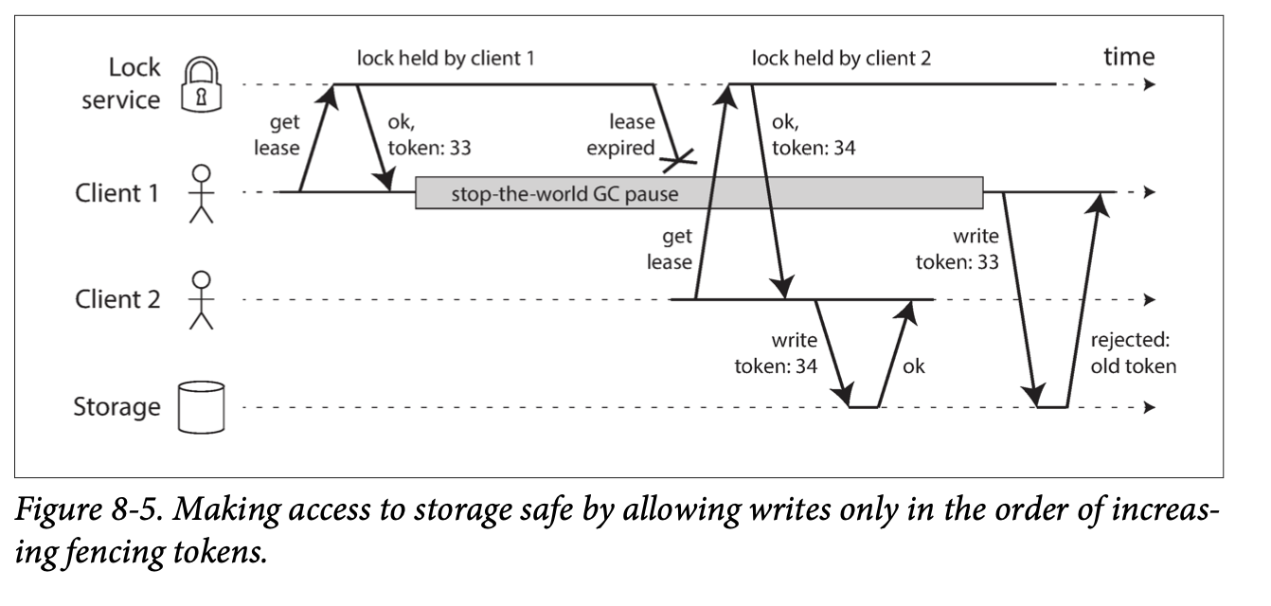
Fencing Tokens - A Solution for Stale State
Notes:
Here's the idea, illustrated in Figure 8-5: Every time the lock service grants a lock or a lease, it doesn't just say 'OK'; it also returns a fencing token. This token is typically a number that is guaranteed to strictly increase every time a lock for that resource is granted. For example, it could be a simple incrementing counter maintained by the lock service, or a transaction ID if the lock service is built on something like ZooKeeper.
Now, the crucial part: when a client wants to perform an operation on the protected resource (like writing to the file in our storage service example), it must include its current fencing token with the request. The resource itself (the storage service in this case) must then enforce the fencing. It needs to keep track of the highest token number it has processed for any given write to that specific file. If it receives a write request with a token that is older (smaller) than a token it has already processed for that file, it rejects the request.
Let's replay our problematic scenario with fencing tokens:
Client 1 acquires the lease and gets token 33. It then goes into its long pause, and its lease expires.
Client 2 acquires the lease for the same file. The lock service, because it's granting a new lease, issues a new, higher token, say 34. Client 2 then sends its write request to the storage service, including its token 34. The storage service sees token 34, processes the write, and remembers 34 as the latest token for this file.
Later, Client 1 wakes up. It still thinks it has the lease and its token is 33. It sends its write request to the storage service, including token 33.
This time, the storage server looks at the incoming token (33) and compares it to the highest token it has already processed for this file (34). Since 33 is less than 34, the storage server rejects Client 1's write.
Data corruption averted! The fencing token effectively 'fences off' the old, stale leader or lock-holder, preventing it from making incorrect writes. This requires the resource server to actively participate in checking these tokens, which is a good thing as it makes the system more robust against misbehaving or misinformed clients.

Slide 21
A Brief Look at System Models (and Byzantine Faults)
To reason about algorithms, we use System Models (abstractions of reality):
Timing Assumptions:
Synchronous: Bounded network delay, pauses, clock error (rarely realistic).
Partially Synchronous: Mostly synchronous, but bounds can be exceeded (realistic).
Asynchronous: No timing assumptions at all (very restrictive).
Node Failure Models:
Crash-stop: Node crashes and never returns.
Crash-recovery: Node crashes, may return (data on stable storage survives).
Byzantine: Nodes can lie or act maliciously (complex to handle).
Most systems: Partially synchronous, crash-recovery.
Byzantine Faults: Nodes actively try to deceive.
Byzantine Generals Problem.
Relevant for trustless environments (e.g., blockchains), aerospace.
Generally not assumed in typical enterprise distributed systems (too complex, costly). We assume nodes are "honest but unreliable."
Algorithms are proven correct within a model (Safety: nothing bad happens. Liveness: something good eventually happens).
Notes:
When computer scientists design and analyze distributed algorithms, they don't usually deal with every single messy detail of reality all at once. Instead, they use system models, which are abstractions that define the kinds of faults and behaviors an algorithm is expected to handle.
These models typically consider a few key aspects. Regarding timing assumptions:
The Synchronous model assumes there are known upper bounds on network delay, process pauses, and clock error. This is a strong assumption and not very realistic for most practical systems.
The Partially Synchronous model is more realistic. It assumes the system behaves like a synchronous one most of the time, but occasionally, these bounds on delay, pauses, and clock drift can be exceeded, and things can become arbitrarily slow or out of sync for a while.
The Asynchronous model is the most pessimistic: it assumes the algorithm can make no timing assumptions whatsoever. It doesn't even have a clock, so it can't use timeouts. This is very restrictive.
Then there are models for node failures:
Crash-stop (or fail-stop) faults: A node can fail only by crashing, and once it crashes, it's gone forever.
Crash-recovery (or fail-recovery) faults: Nodes can crash, but they might restart later. We usually assume they have stable storage (like a disk) where data can survive the crash, but their in-memory state is lost.
And then there are Byzantine faults. This is where nodes don't just fail; they can actively lie, send malicious messages, or deviate from the protocol in arbitrary ways. The classic problem here is the Byzantine Generals Problem.
For most of the systems we build for web services or enterprise applications, the partially synchronous model with crash-recovery faults is often the most appropriate and useful one. We generally assume nodes are 'honest but unreliable' – they might crash, be slow, have skewed clocks, or lose messages, but they don't intentionally try to sabotage the system.
Handling true Byzantine faults is very complex and computationally expensive. It's crucial for systems where participants don't trust each other, like public blockchains, or in extremely safety-critical systems like aerospace. But for internal systems within a single organization, we usually assume we don't have Byzantine actors.
Finally, when we say an algorithm is 'correct', we often describe its properties in terms of Safety (meaning nothing bad ever happens, like returning a duplicate fencing token) and Liveness (meaning something good eventually happens, like a request eventually receiving a response, assuming faults are repaired). Algorithms are proven correct if they uphold these properties within the assumed system model

Slide 22
Summary & Key Takeaways
Distributed systems are hard because of partial failures, unreliable networks, unreliable clocks, and process pauses.
This leads to fundamental uncertainty.
Key strategies & concepts:
Timeouts for fault detection (imperfect).
Understanding queueing and unbounded delays.
Distinguishing monotonic vs. time-of-day clocks.
Quorums for agreement and fault tolerance.
Fencing tokens to prevent issues from stale state.
Designing for failure is not optional; it's essential.
Pessimism pays off: Assume things will go wrong.
Notes:
So, we've been through a whirlwind tour of the troubles that plague distributed systems, as laid out in Chapter 8. Let's try to distill the main takeaways.
The core message is that distributed systems are fundamentally different and harder than single-computer programming primarily because of the possibility of partial failures. Things don't just work or break completely; parts of the system can be in various states of disarray. This is compounded by three major culprits:
Unreliable Networks: Packets get lost or arbitrarily delayed. You can't know if a message got through without a response, and even then, the response might be lost or delayed.
Unreliable Clocks: Each node's clock is imperfect, drifts, and can jump. Relying on them for precise ordering or synchronization across nodes is dangerous.
Process Pauses: Your code can stop running for significant periods due to garbage collection, VM activity, or other system events, and then resume as if nothing happened, potentially with stale knowledge.
All of this leads to a pervasive and fundamental uncertainty for any node trying to understand the state of the system.
We touched on some key concepts and strategies for dealing with this:
Using timeouts as the primary, albeit imperfect, mechanism for detecting faults.
Understanding that queueing is a major cause of unbounded and variable network delays.
The critical importance of distinguishing between monotonic clocks (for measuring durations) and time-of-day clocks (for calendar time, used with extreme caution).
The use of quorums (majority voting) to make decisions, define truth, and provide fault tolerance.
Techniques like fencing tokens to prevent nodes operating on stale information (like an expired lease) from corrupting data.
The overarching lesson is that designing for failure is not an optional extra in distributed systems; it's an absolute necessity. You cannot simply hope for the best. As the chapter suggests, a healthy dose of suspicion, pessimism, and paranoia is actually beneficial. Assume things will go wrong, in all sorts of unexpected ways, and build your system to handle that gracefully. While this chapter paints a somewhat bleak picture, understanding these problems is the first crucial step towards building more robust and reliable distributed applications.

Slide 23
Live Discussion
Has anyone here ever dealt with a system outage where the root cause was later found to be a ‘partial failure’ or a timeout misconfiguration?
Has anyone here ever implemented distributed locks in your system? How do you ensure correctness when nodes pause or become partitioned?
Notes:
That brings us to the end of this overview of 'The Trouble with Distributed Systems.' We've covered a lot of challenging ground. Hopefully, this gives you a better appreciation for the complexities involved and some of the core problems that distributed systems engineers grapple with every day.
Let's open the group up for discussion with these questions.

